Slide 1
Full Open-Source CI/CD of a dotnet core application
Tech@Agoda
Presented by Cédric Rochefolle
Annop Mungnimit
Patthaphol Kulthawaiporn

Slide 2
Agenda
Definitions
Tools
Application
Build System
Code Coverage
Code Analysis
Hosting

Slide 3
What is CI/CD
Continuous Integration is the practice of integrating all developer codes to a repository several times a day. Every time code is checked-in, an automated build compiles and test the code for early feedback.
Continuous Delivery is a software engineering approach in which teams produce software in short cycles, ensuring that the software can be reliably released at any time. The approach helps reduce the cost, time, and risk of delivering changes by allowing for more incremental updates to applications in production.

Slide 4
Open-Source
The open-source model is a decentralized software-development model that encourages open collaboration. A main principle of open-source software development is peer production, with products such as source code, blueprints, and documentation freely available to the public.
Open-Source doesn’t necessarily mean free: source-code can be freely available, but running the software in production might require a license fee.
Key is contribution: allow software improvement through the community

Slide 5
Tools
An IDE: VS Code for this demo, but any IDE that supports C# and nodeJS
Git: I will use command line
NodeJs: mostly for the build environment
Yarn (or NPM)
Dotnet core 2.1 (other version should work fine)
Azure CLI SDK (and OpenSSL)

Slide 6
Codeshare.io
I will paste links and long content to
https://codeshare.io/TechAtAgoda20180804

Slide 7


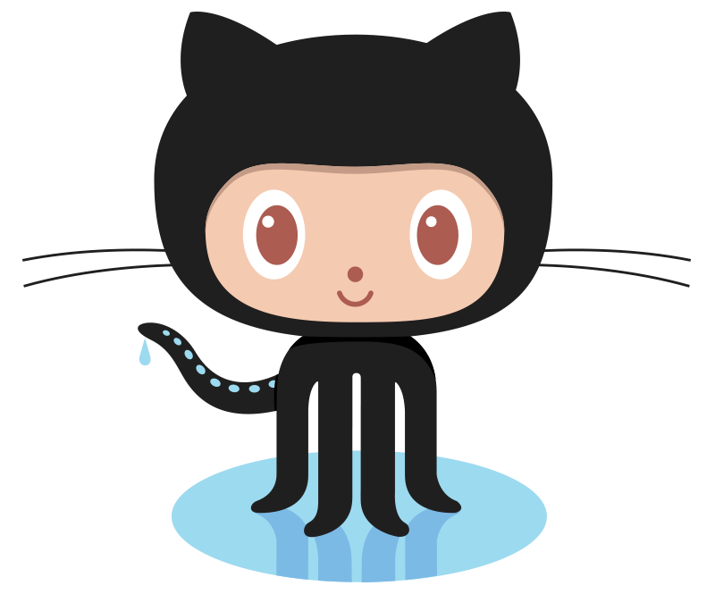





Slide 8
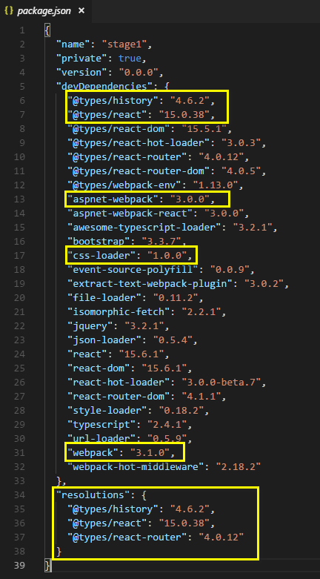
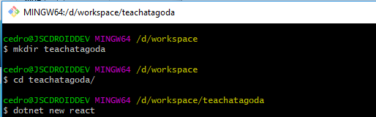
Creating The Application
Now you can run either
‘npm install’ or ‘yarn install’
Delete ‘npm-shrinkwrap.json’ if you use yarn
Do not run ‘npm install’ … not yet

Slide 9
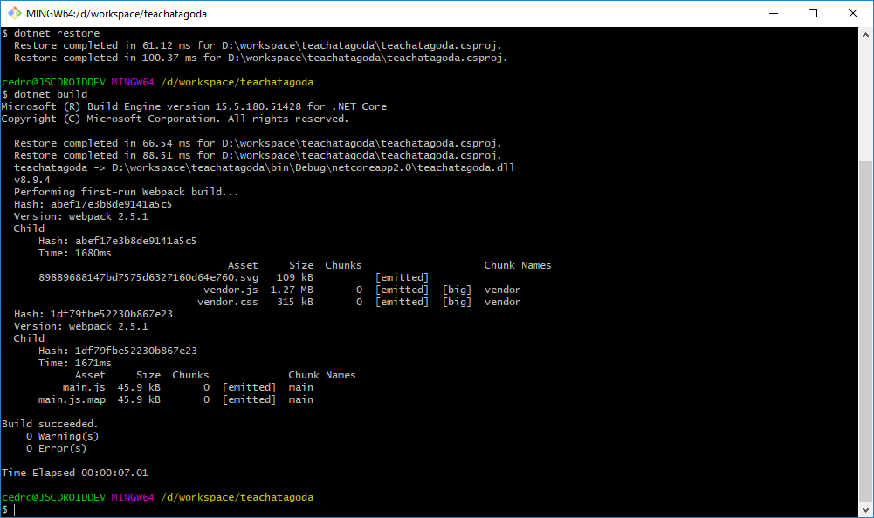
Let’s run it
dotnet restore
dotnet build
ASPNETCORE_ENVIRONMENT=Development dotnet run
Then open a browser on http://localhost:5000

Slide 10
Setup GitHub
Create an account at GitHub (if you don’t already have one)
Create a project in GitHub
Create a SSH key (if you don’t already have one)
Upload your key

Slide 11
Setup Git repository
Initialize a repository
git init
Add assets to the repository
git add .
Verify the content
git status
Commit the source
git commit -m “Initial commit”
Set the remote location
git remote add origin git@github.com:CedricAgoda/techatagoda-cicd.git
“Push” the changes to the remote location on GitHub
git push -u remote master
Setup global variables
git config --global user.name=“Cedric Rochefolle”
git config --global user.email=“cedric.rochefolle@agoda.com”
Or use private email in GitHub

Slide 12
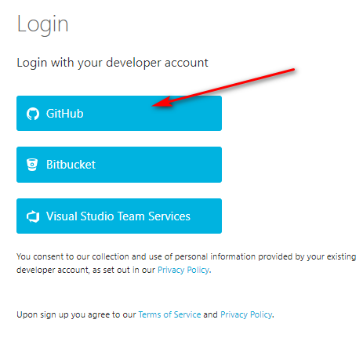
Appveyor
Go to appveyor.com
Go to the “Sign-in” link
Use the “GitHub” link
Click the “New Project” link
Select the GitHub link
Authorize GitHub
Click on your project

Slide 13
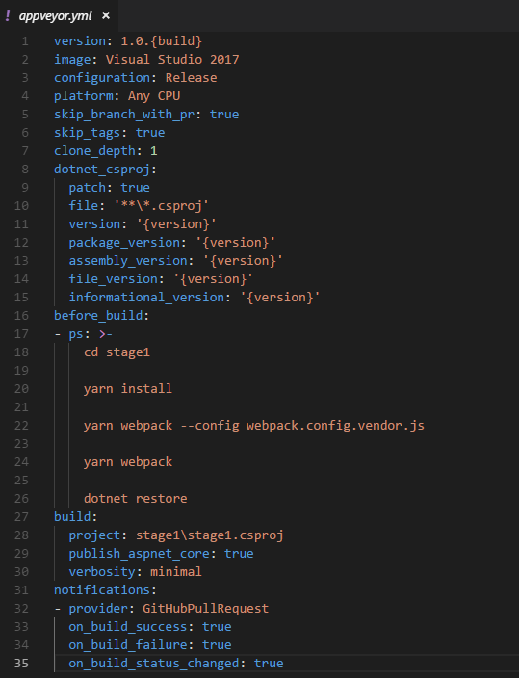
Save the YAML

Slide 14
Let’s add Unit Tests
Create a new folder at same level
cd ..
mkdir tests
cd tests
dotnet new xunit
Add reference to the project (use your .csproj path)
dotnet add reference ../src/stage1.csproj
dotnet restore

Slide 15
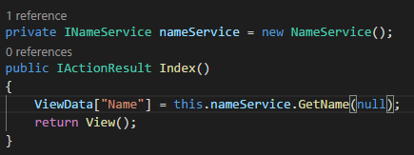
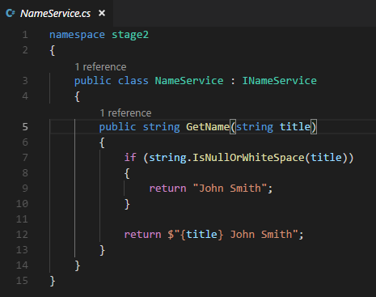
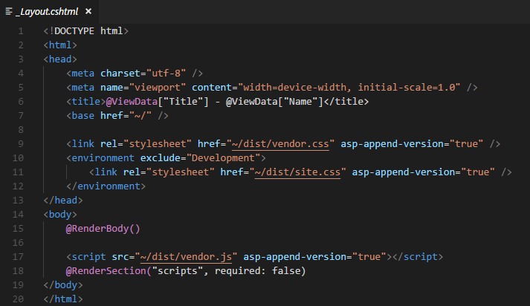
Create a dummy Service

Slide 16
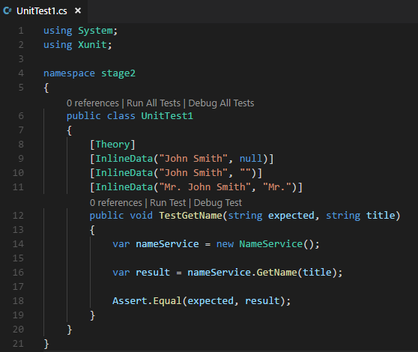
Add Unit Test

Slide 17
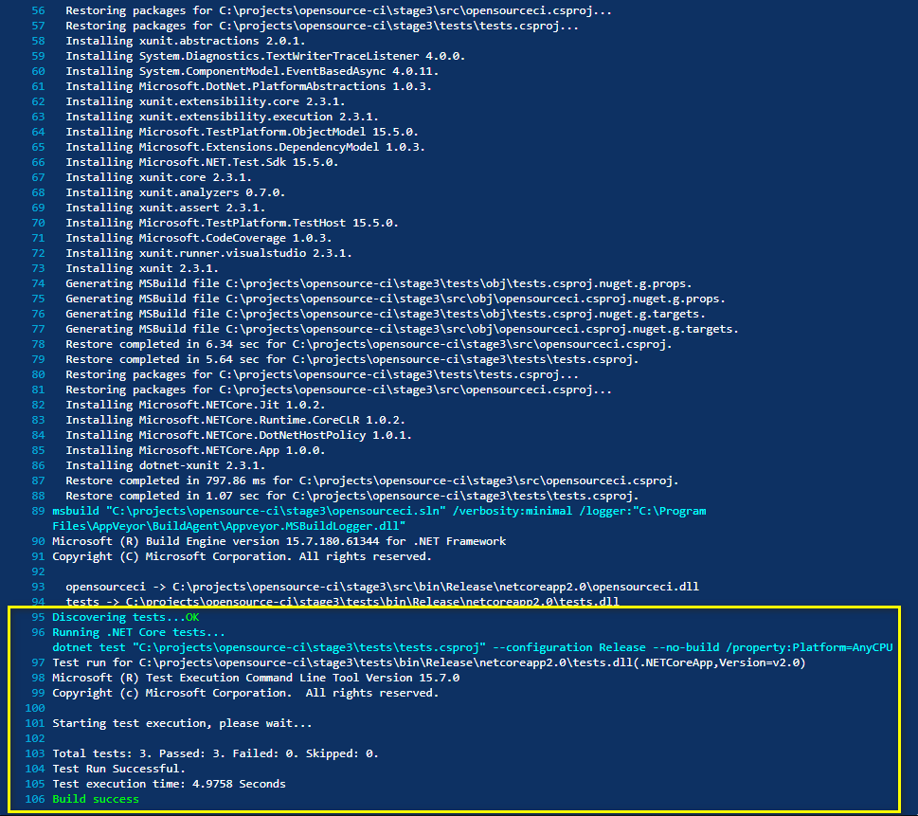
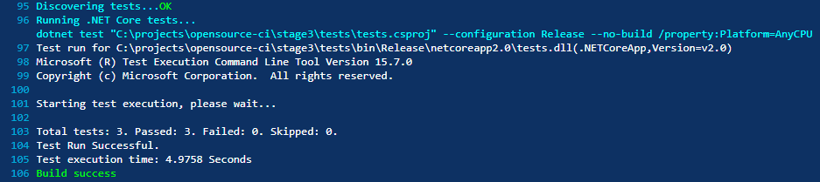
Run tests in CI

Slide 18
Let’s add Code Coverage
Opencover parameters:
register: to register the code coverage (the OS will not let you inspect DLL if this setting is not correct). In our case, use “-register:user”
oldStyle: used for pre-Silverlight code. It also helps to inspect dotnet core code ☺
target: what command to execute
targetargs: the parameters to run the above command
filter: to include/exclude code to cover (namespace names, supports wildcard)
output: the XML to output that can be sent to reporting
Add opencover dependency
dotnet add package opencover
dotnet restore
Find the local nuget folder
dotnet nuget locals -l global-packages
Run opencover
& $HOME\.nuget\packages\opencover\4.6.519\tools\OpenCover.Console.exe -register:user -oldStyle -target:"dotnet.exe" -targetargs:"test tests.csproj" -filter:"+[opensourceci*]* +[tests*]*" -output:"coverage.xml"

Slide 19
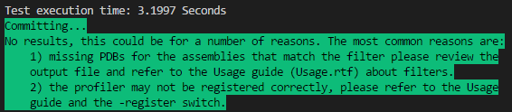
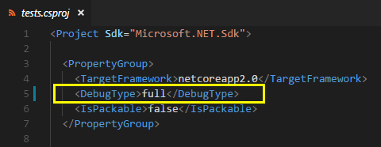
But… it doesn’t work ☹
We need to add “FULL” debug mode in both application and test projects:

Slide 20
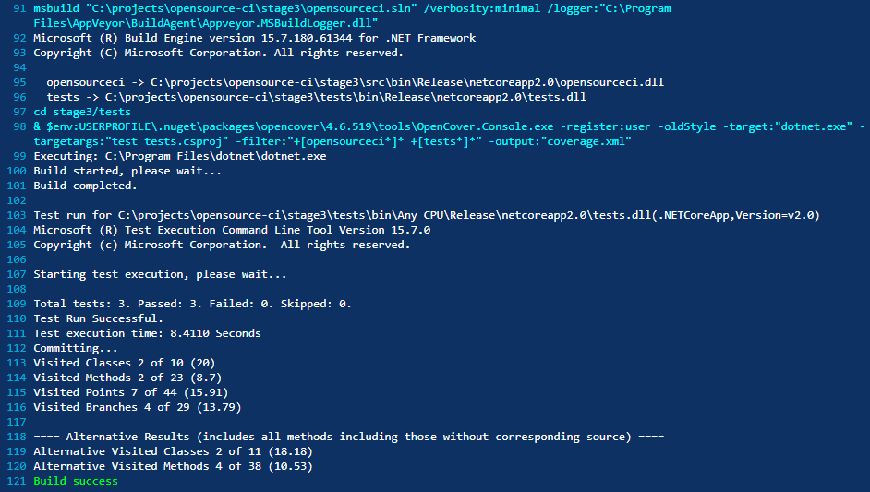
Let’s run this in the CI
Why build again???
We can add “--no-build” to the “targetargs”
-targetargs:"test --no-build tests.csproj"

Slide 21
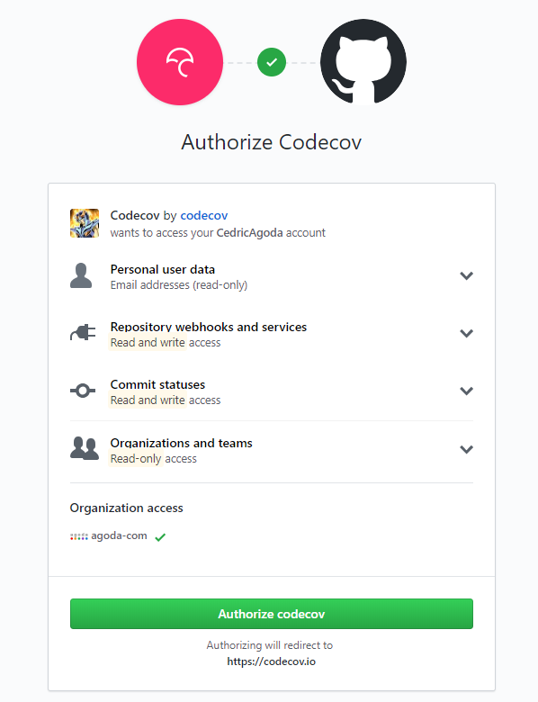
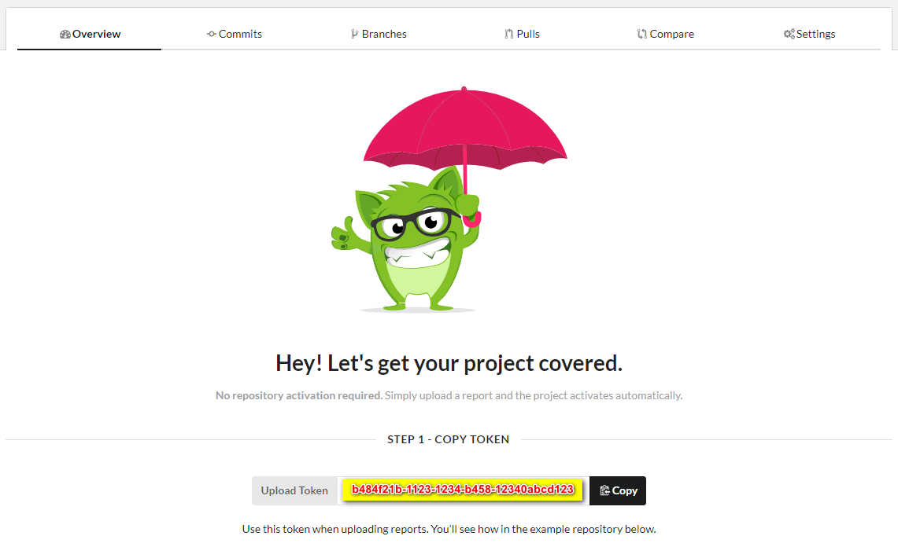
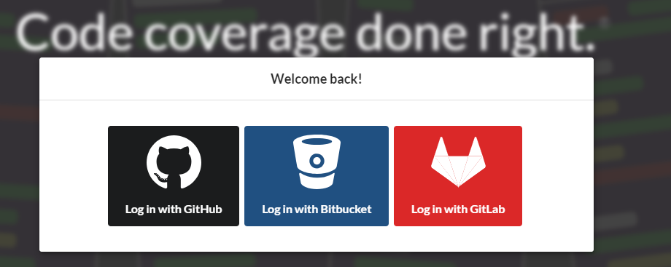
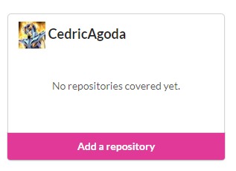
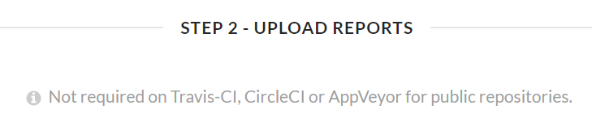
Pushing code coverage to CodeCov
Go to https://codecov.io
Click on Sign-in

Slide 22
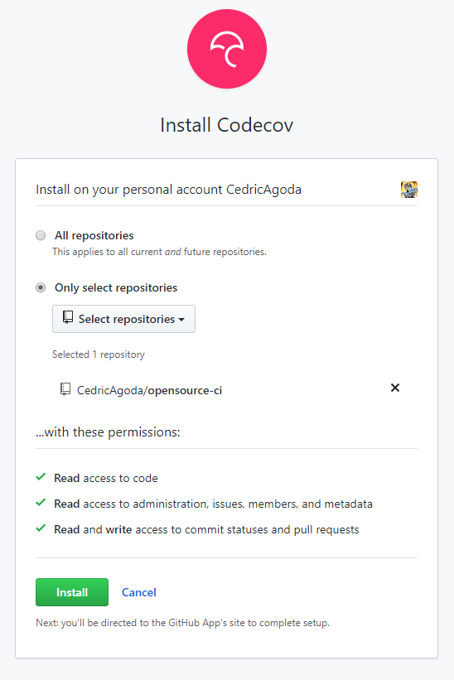
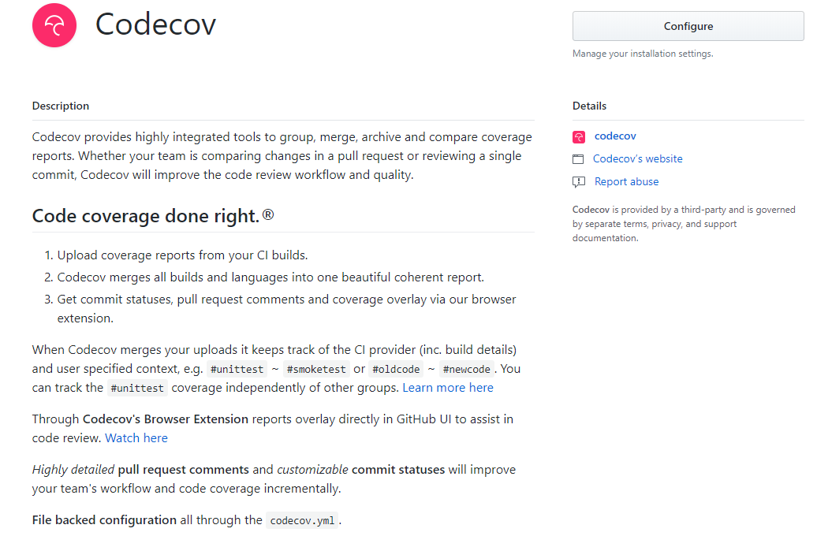
Authorize Codecov in github

Slide 23
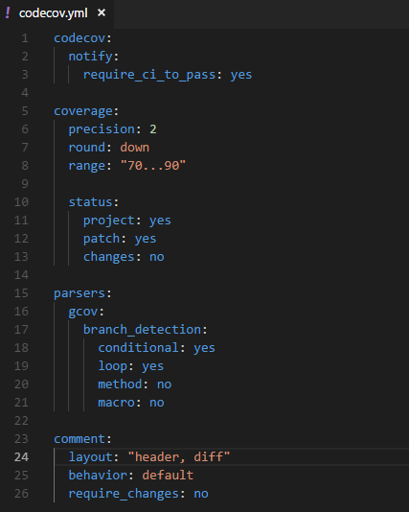
Create a YAML for Codecov

Slide 24
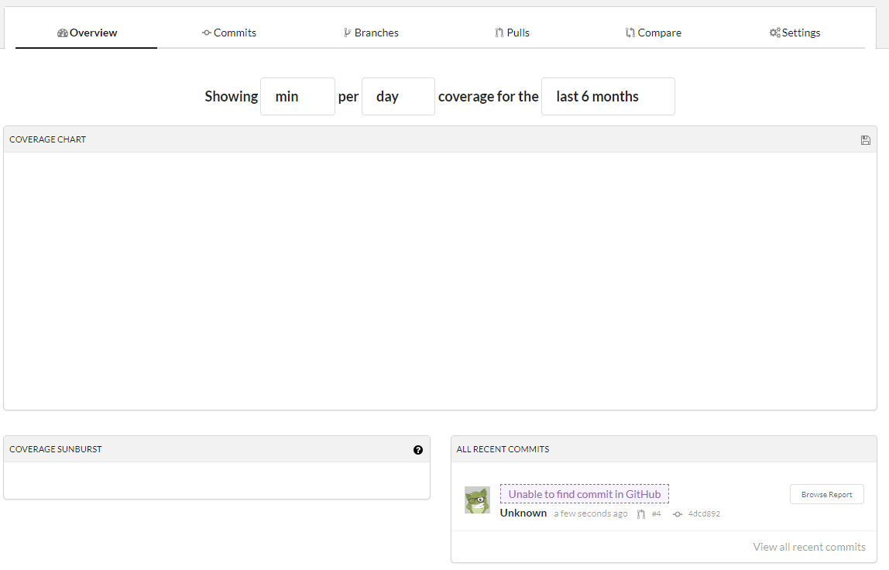
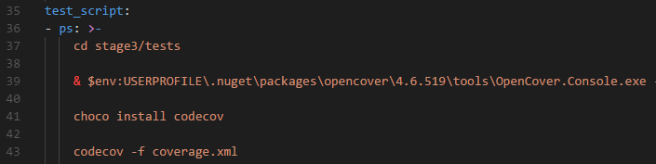
Run the codecov plugin
After successful build and push to the PR, you will need to push to the master (or default) branch for codecov to be properly indexing things

Slide 25
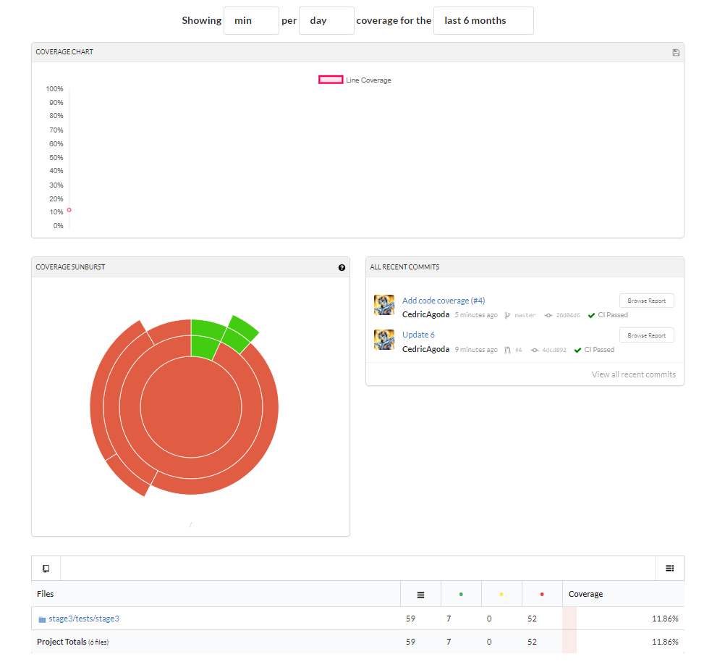
Codecov dashboard

Slide 26
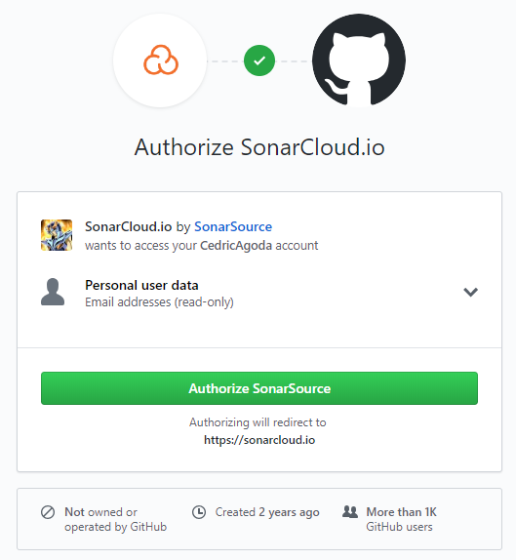
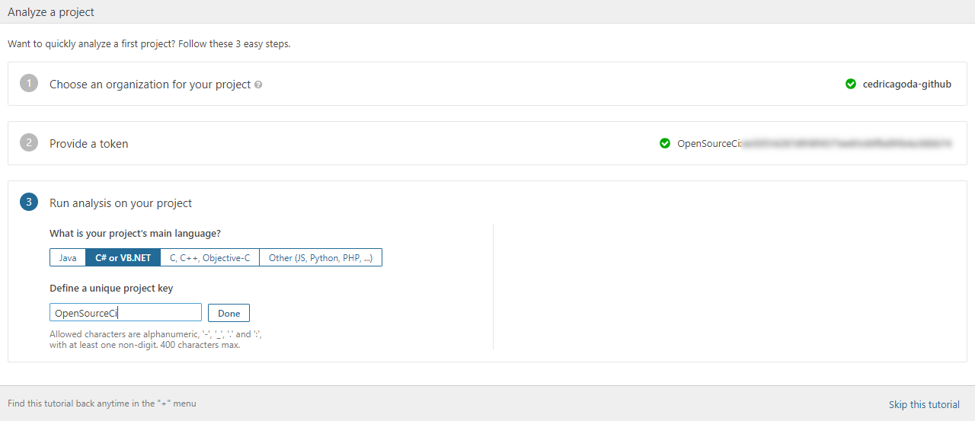
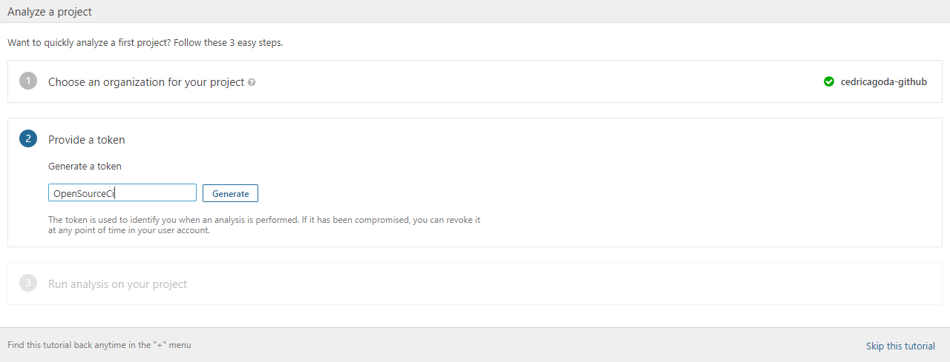
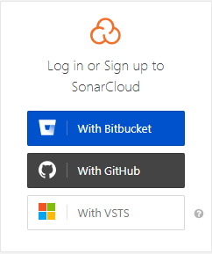
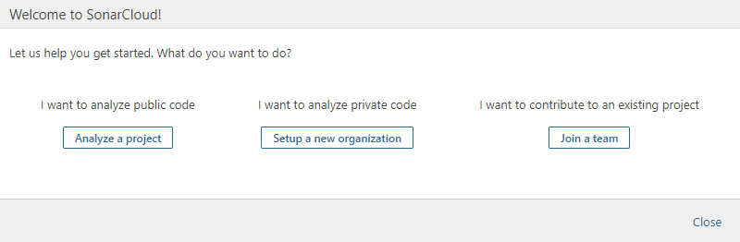
Let’s add Static Code Analysis
Got to https://sonarcloud.io
Click on “Log-In”

Slide 27
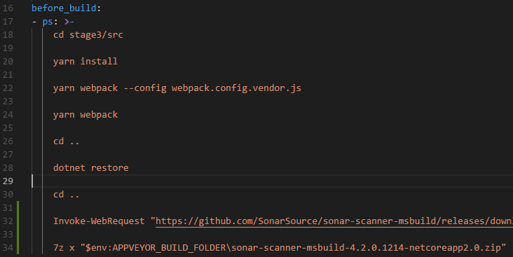
Aww…
Add in the appveyor.yml file
Invoke-WebRequest "https://github.com/SonarSource/sonar-scanner-msbuild/releases/download/4.3.1.1372/sonar-scanner-msbuild-4.3.1.1372-net46.zip" -OutFile "$env:APPVEYOR_BUILD_FOLDER\sonar-scanner-msbuild-4.2.0.1214-netcoreapp2.0.zip"
7z x "$env:APPVEYOR_BUILD_FOLDER\sonar-scanner-msbuild-4.2.0.1214-netcoreapp2.0.zip" -o"$env:APPVEYOR_BUILD_FOLDER\sonar-scanner-msbuild"
We need to download the SonarScanner for MSBuild
We’ll add the download in the before_build step

Slide 28
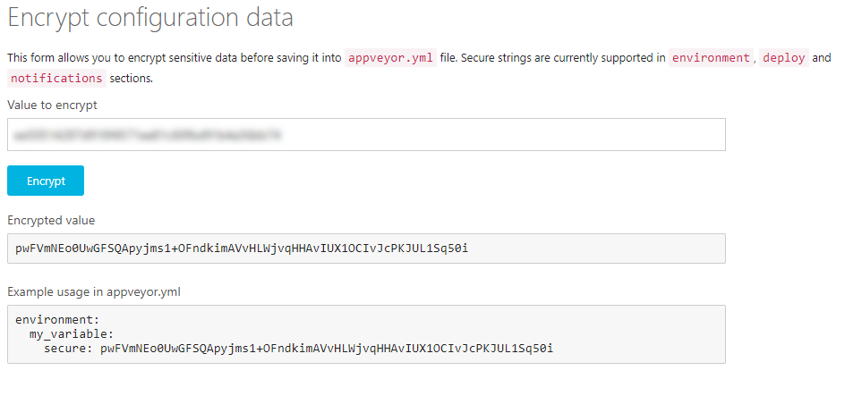
Creating a Secret Key
Go to https://ci.appveyor.com/tools/encrypt

Slide 29
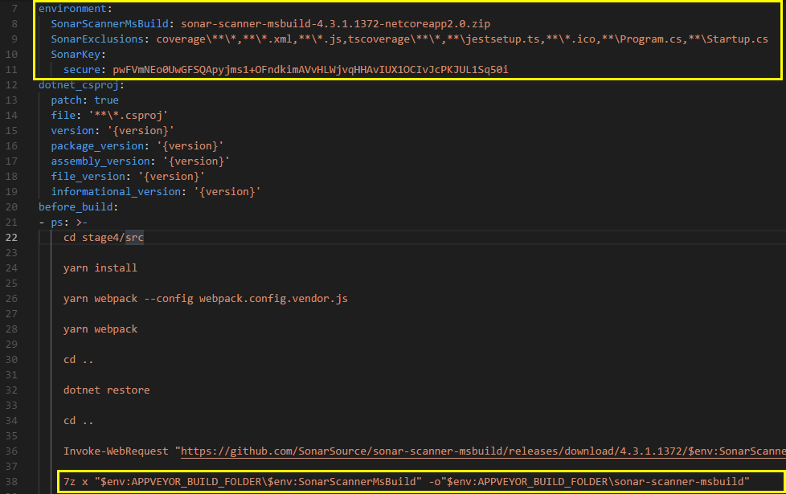
SonarQube configuration
Add in the appveyor.yml file
environment:
SonarScannerMsBuild: sonar-scanner-msbuild-4.3.1.1372-netcoreapp2.0.zip
SonarExclusions: coverage\**\*,**\*.xml,**\*.js,tscoverage\**\*,**\jestsetup.ts,**\*.ico,**\Program.cs,**\Startup.cs
SonarKey:
secure: pwFVmNEo0UwGFSQApyjms1+OFndkimAVvHLWjvqHHAvIUX1OCIvJcPKJUL1Sq50i
------------------------
dotnet "$env:APPVEYOR_BUILD_FOLDER\sonar-scanner-msbuild\SonarScanner.MSBuild.dll" begin /k:opensource-ci /v:$env:APPVEYOR_BUILD_VERSION /d:sonar.organization=cedricagoda-github /d:sonar.host.url="https://sonarcloud.io" /d:sonar.cs.opencover.reportsPaths="coverage.xml" /d:sonar.login="$env:SonarKey" /d:sonar.exclusions="$env:SonarExclusions"

Slide 30
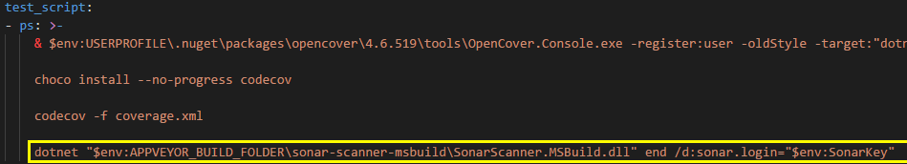
More configuration

Slide 31
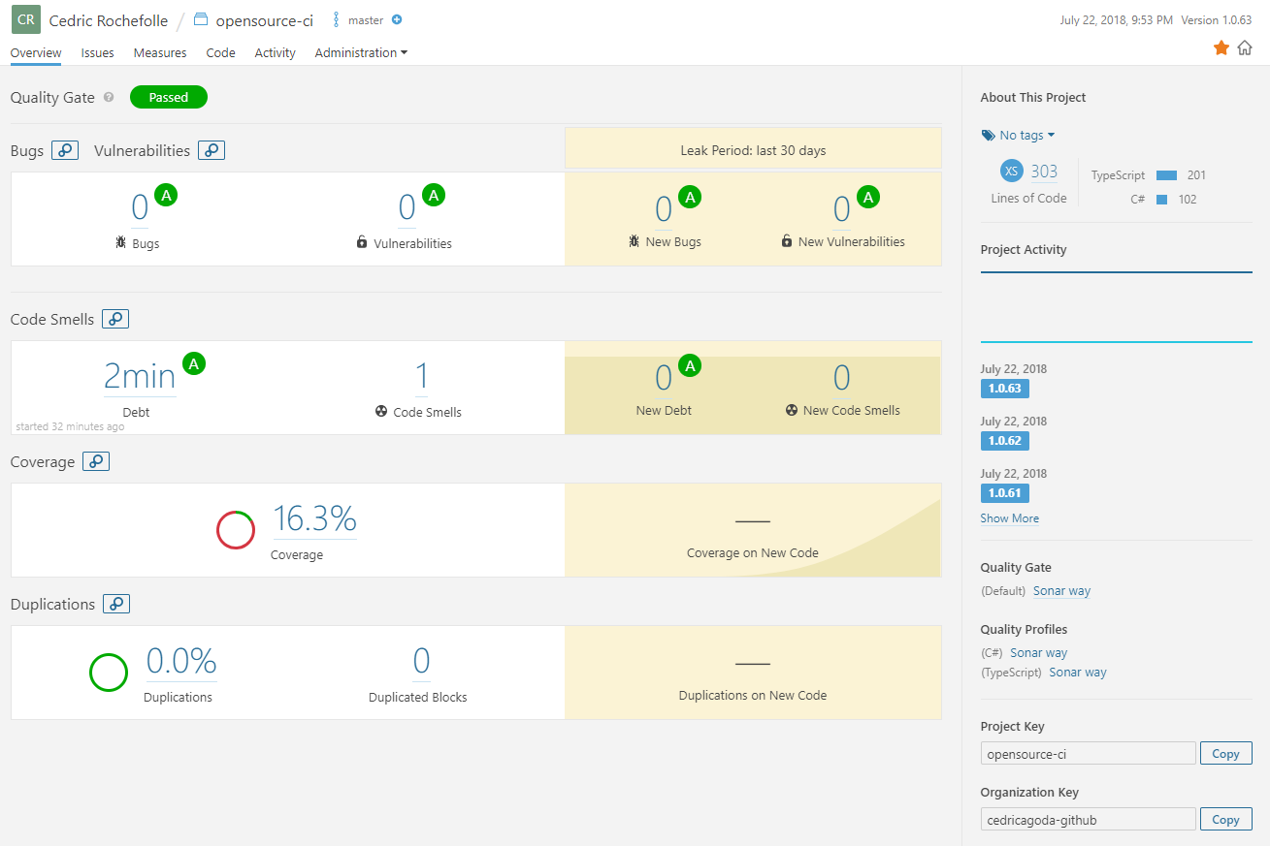
Let’s see in SonarCloud

Slide 32
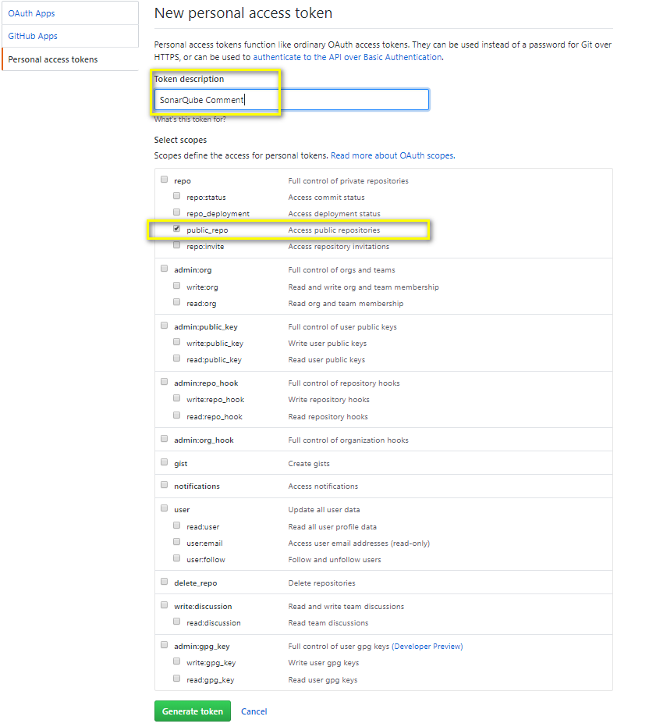
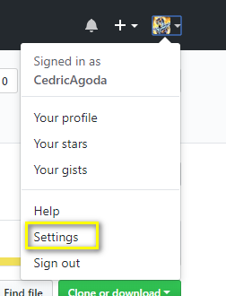
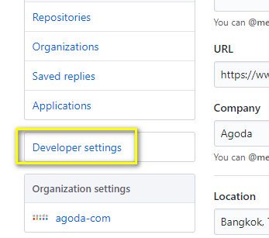
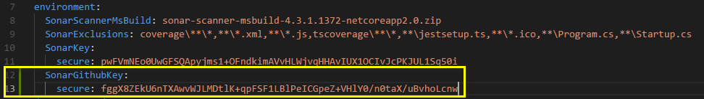
Let’s add SQ postback to github

Slide 33
And let’s report back
For pull requests, we can report back to GitHub and block a merge
We can add an ‘if’ statement and if it is a PR we can add to the ‘begin’ command
We can add some mistake to see the effect.
/d:sonar.analysis.mode=preview /d:sonar.github.pullRequest=$env:APPVEYOR_PULL_REQUEST_NUMBER /d:sonar.github.repository=$env:APPVEYOR_REPO_NAME /d:sonar.github.oauth=$env:SonarGithubKey

Slide 34
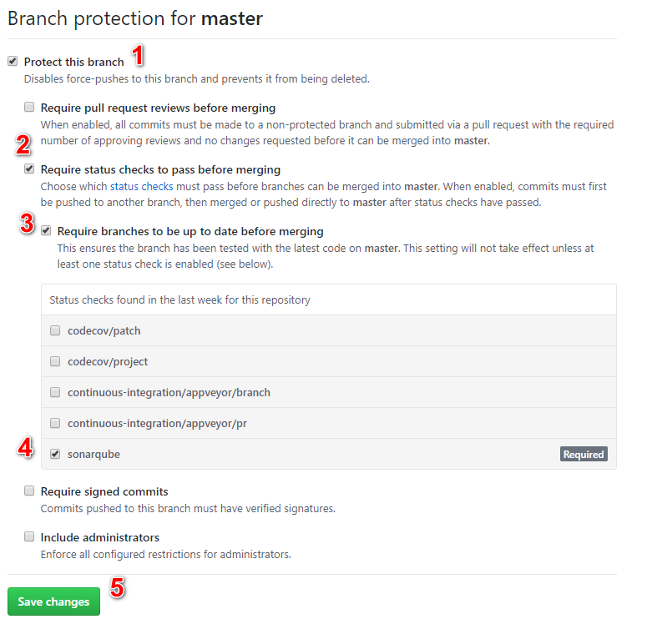
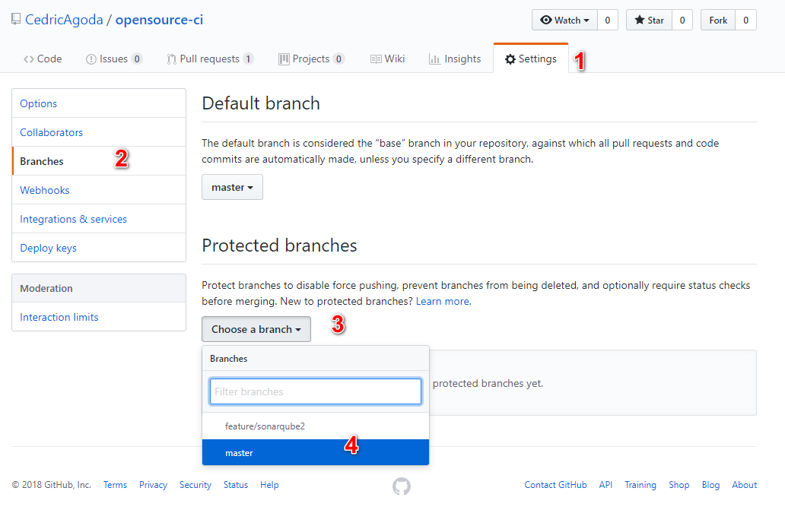
Let’s protected the branch
In order to prevent bad code to be merged to your master branch, you can protect it
To do so you add “required” statuses (remember the custom statuses in AppVeyor?)

Slide 35
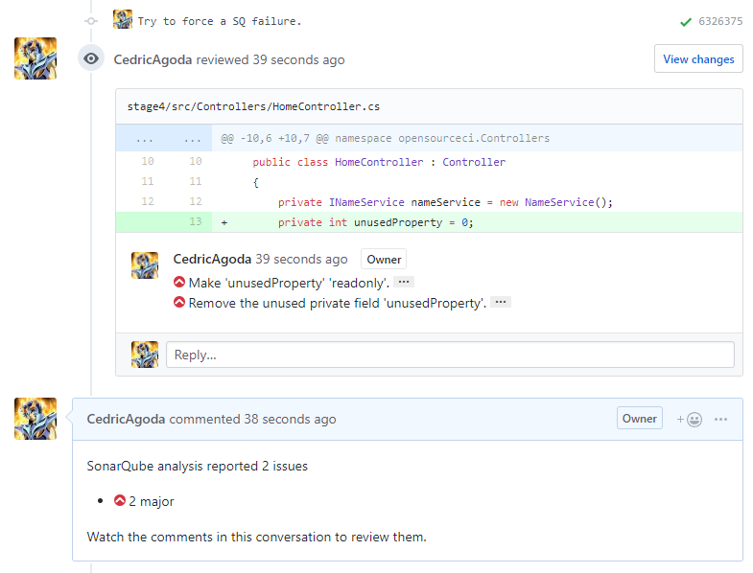
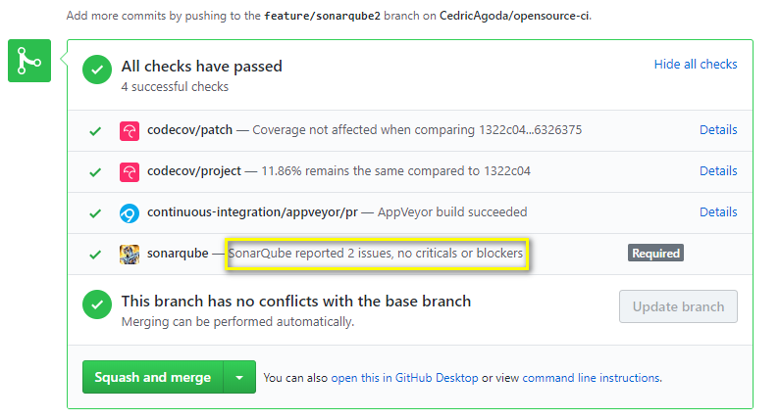
Result of non-blocking errors

Slide 36
Let’s be code-nazi ☺
Quality Profile:
We can define in SonarQube what rules to enable or disable
We can also define the level of an issue
Quality Gate:
We can define what are the threshold to consider a code version to pass or not the level of quality we define. Examples:
Fail if < 40% code coverage
Fail if > 2 days of technical debt

Slide 37
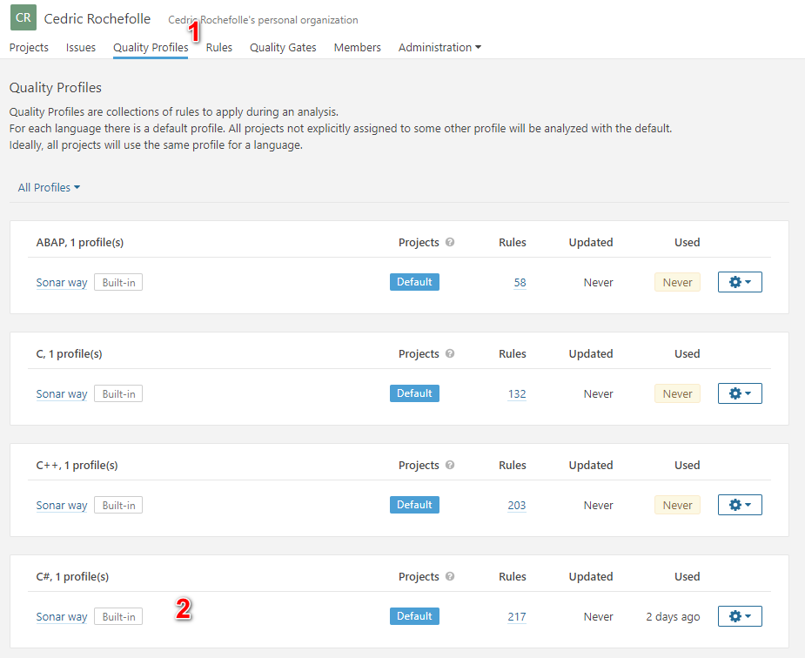
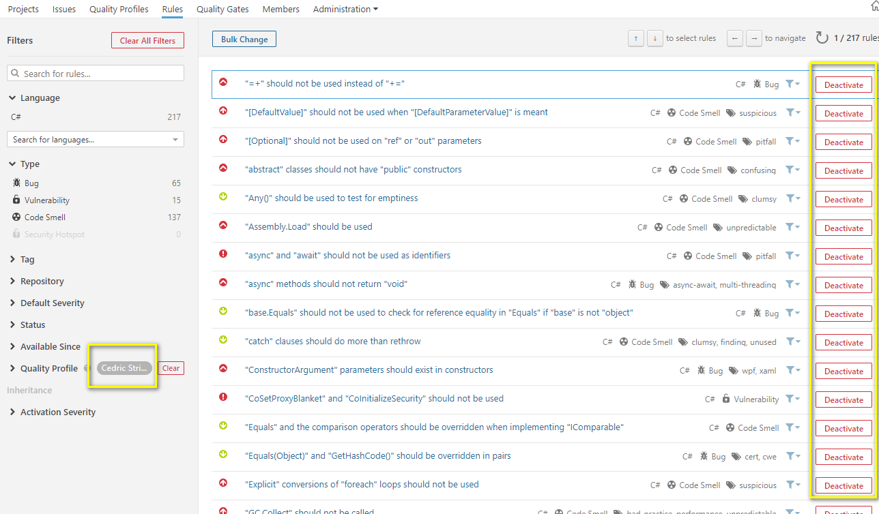
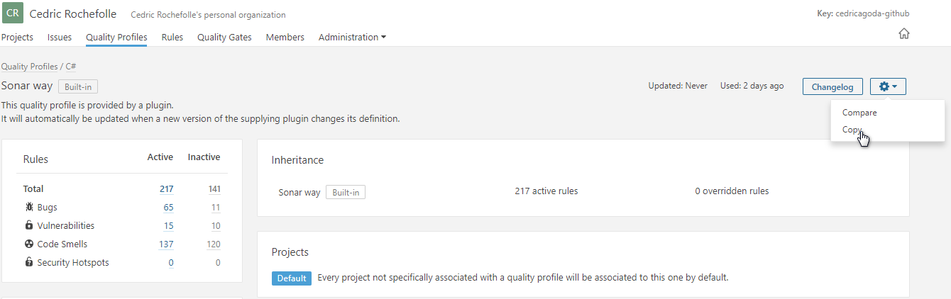
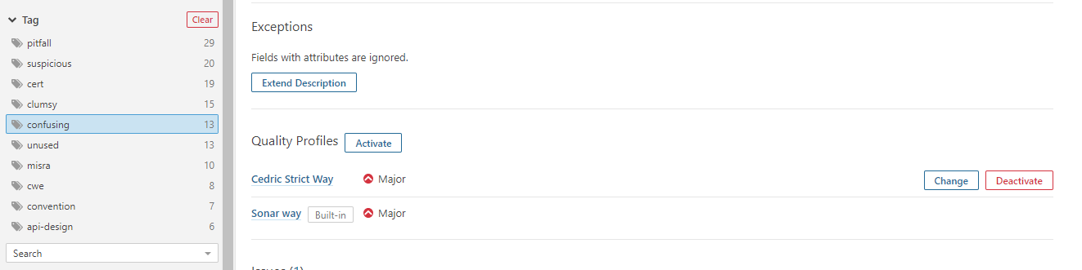
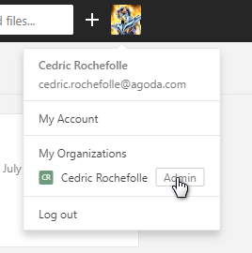
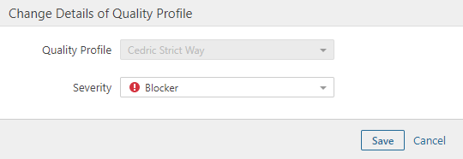
How to change SonarQube rules and levels

Slide 38


Kaboom!
Fix the code and push to clear the issue

Slide 39
Recap and clean-up
Created a dotnet core + react application using CLI scaffolding
Added it to GitHub
Added an automated build on Appveyor
Added code analysis and coverage
Publish code stats to SonarCloud and CodeCov
Now it’s time to deploy to Azure!

Slide 40


First let’s get secure
$cert = New-SelfSignedCertificate -DnsName management.azure.cloudapp.net -CertStoreLocation "cert:\LocalMachine\My" -KeyLength 2048 -KeySpec "KeyExchange“
$password = ConvertTo-SecureString -String "Password12" -Force -AsPlainText
Export-PfxCertificate -Cert $cert -FilePath ".\azure-manage-cert.pfx" -Password $password
Export-Certificate -Type CERT -Cert $cert -FilePath .\azure-manage-cert.cer
openssl pkcs12 -in azure-manage-cert.pfx -password pass:Password12 -nodes -out temp.pem
openssl pkcs12 -export -in temp.pem -passout pass: -out azure-manage-cert.pfx
del temp.pem
[Convert]::ToBase64String((Get-Content -Path ".\azure-manage-cert.pfx" -Encoding Byte)) | Out-File ".\azure-manage-cert.pfx.txt"
If you don’t have it, download OpenSSL binaries and extract to a folder:
http://gnuwin32.sourceforge.net/packages/openssl.htm
Open a PowerShell as Administrator and run those commands

Slide 41

Create the storage Account

Slide 42

Create the Azure Cloud Instance
Sign-in to your https://portal.azure.com/
Navigate to “All Services” → “Subscriptions” → <your subscription id> → “Management Certificates”
Upload the azure-manage-cert.cer file
Encrypt in AppVeyor the content of azure-manage-cert.pfx.txt

Slide 43


Create the Azure Cloud Instance (cont.)
Select “West Central US” for Location if you are using a Free Trial account

Slide 44
Update AppVeyor.yml

Slide 45
Links and credits
GitHub: https://github.com
Appveyor: https://appveyor.com
Codecov: https://codecov.io
SonarCloud: https://sonarcloud.io
Opencover: https://github.com/opencover/opencover/wiki/Usage
Azure Portal: https://portal.azure.com/
My Visual Studio: https://my.visualstudio.com

